Slide 1
COURSE NAME: COURSE CODE:
ARTIFICIAL INTELLIGENCE
CIS 412
SYED TANGIM PASHA
LECTURER,
DEPARTMENT OF COMPUTING AND INFORMATION SYSTEM (CIS)
DAFFODIL INTERNATIONAL UNIVERSITY (DIU)
DHAKA,BANGLADESH

Slide 2
NAÏVE BAYES
Naïve Bayes: Naïve Bayes algorithm is a supervised learning algorithm, which is based on Bayes theorem and used for solving classification problems.
It is mainly used in text classification that includes a high-dimensional training dataset.
Naïve Bayes classifier is one of the simple and most effective classification algorithms which helps in building the fast machine learning models that can make quick predictions.
It is a probabilistic classifier, which means it predicts on the basis of the probability of an object.
Some popular examples are: Spam filter, Sentiment analysis, Classifying articles.

Slide 3
Why is it called Naïve Bayes
The Naïve Bayes algorithm is compromised of two words Naïve and Bayes, which can be described as:
Naïve: It is called Naïve because it assumes that the occurrence of a certain feature is independent of the occurrence of other features. Such as if the fruits is identified on the bases of color, shape and taste then red, spherical and sweet fruit is recognized as an apple. Hence each feature individually contributes to identify that it is an apple without depending on each other.
Bayes: It is called Bayes because it depends on the principle of Bayes Theorem.

Slide 4

Bayes Theorem
Bayes Theorem, is also known as Bayes rule or Bayes law which is used to determine the probability of a hypothesis with prior knowledge. It depends on the conditional probability.
The formula for Bayes theorem is given as:

Slide 5
NAÏVE BAYES
Suppose we have a dataset of weather conditions and corresponding target variable ‘Play’. So, using this dataset we need to decide that whether we should play or not on a particular day according to the weather conditions. So to solve this problem, we need to follow the below steps:
Convert the given dataset into frequency table.
Generate Likelihood table by finding the probabilities of given features.
Now, use Bayes Theorem to calculate the posterior probability.

Slide 6
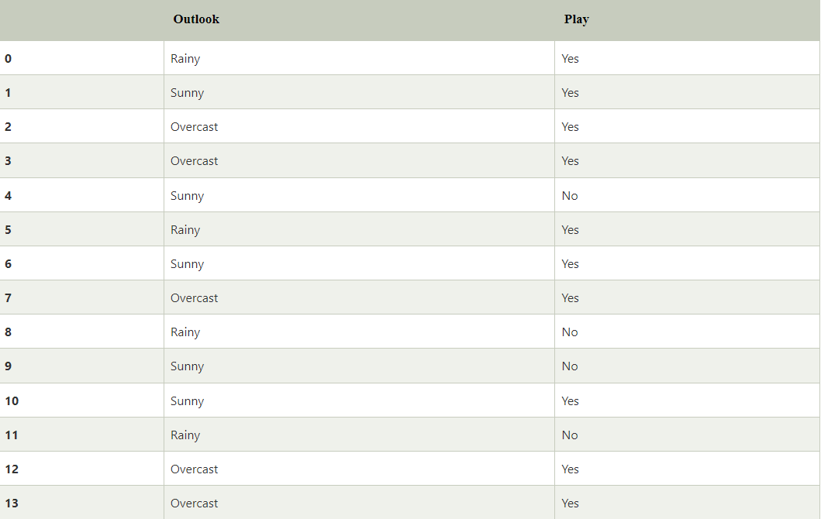
NAÏVE BAYES
Problem: If the weather is sunny, then the player should play or not?
Solution:

Slide 7
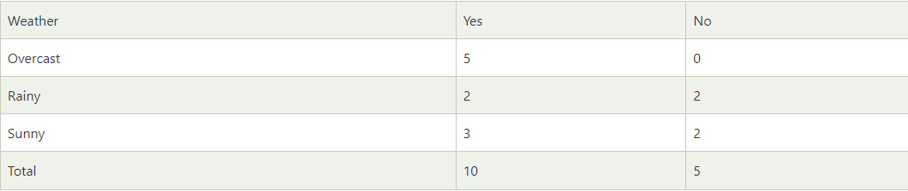
NAÏVE BAYES
FREQUENCY TABLE FOR THE WEATHER CONDITIONS:
4

Slide 8
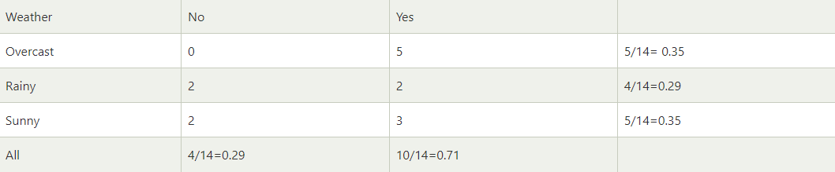
NAÏVE BAYES
LIKELIHOOD TABLE WEATHER CONDITION:

Slide 9
NAÏVE BAYES
Applying Bayes Theorem:
P(Yes|Sunny)=( P(Sunny|Yes)*P(Yes) )/P(Sunny)
P(Sunny/Yes)=3/10=0.3
P(Sunny)=0.35
P(Yes=0.71
So, P(Yes|Sunny)=(0.3 * 0.71)/0.35=0.60

Slide 10
NAÏVE BAYES
Applying Bayes Theorem:
P(No|Sunny)=( P(Sunny|No) * P(No) )/P(Sunny)
P(Sunny|No)=2/4=0.5
P(No)=0.29
P(Sunny)=0.35
So, P(No|Sunny)=(0.5*0.29)/0.35=0.41
So, as we can see from the above calculation that P(Yes|Sunny) > P(No|Sunny)
Hence on a Sunny day, Player can play the game.

Slide 11
NAÏVE BAYES
There are three types of Naïve Bayes model, which are given below:
Gaussian: The Gaussian model assumes that features follow a normal distribution. This means if predictors take continuous values instead of discrete, then the model assumes that these values are sampled from the Gaussian distribution.
Multinomial: The multinomial Naïve Bayes classifier is used when the data is multinomial distributed. It is primarily used for document classification problems, it means a particular document belongs to which category such as Sports, Politics, education etc.
Bernoulli: The Bernoulli classifier works similar to the multinomial classifier, but the predictor variables are the independent Booleans variables. Such as if a particular word is present or not in a document.

Slide 12
QUESTIONS???
Why Naïve Bayes works better than other ML models in classification task?
If the dataset is huge that time how Naïve Bayes works?
What is the relationship between Bayes Theorem and Naïve Bayes?

